Slide 1
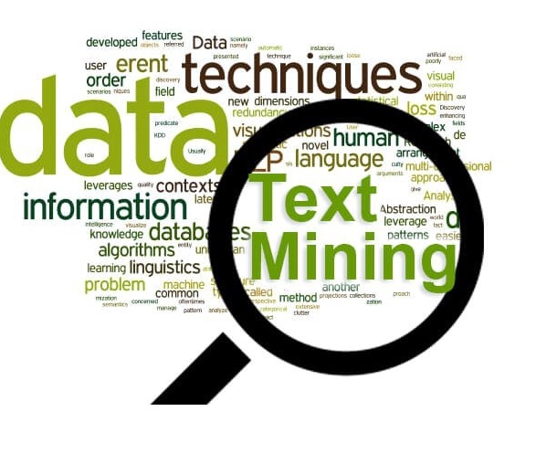
Text Analytics Project
By
Rohan Sunki
Sagar Kulkarni
Vijay Venkata Kambhampati
Vidya Sagar Gunnala
Date: 4/24/2020

Slide 2




Text Mining Employer Brand and Employee Satisfaction of 4 major employers in US

Slide 3

Motivation
Employer brand is not a logo or career page but the emotional reaction people have to the idea of working for a company
Employer brand lives and breathes in the minds and hearts of former, current and future employees
Companies with positive employer brands can get up to twice as many applicants as companies with negative brands
What it costs companies when they fail to build a positive employer brand?
On an average, $5000 per employee

Slide 4

Goal
Identify the characteristics of these companies which are helping in improving the employer brand and the characteristics which are hurting the employer brand
Analyze the employee satisfaction with these companies

Slide 5
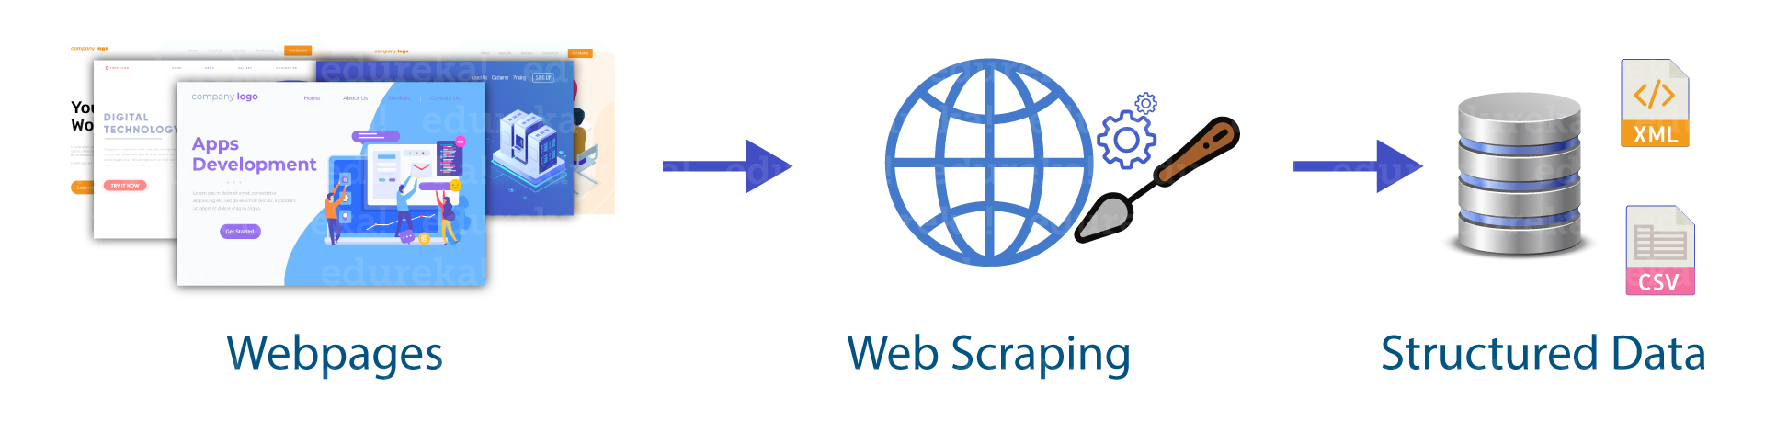
Corpus Creation
Abundant social media data made the data gathering easy for employee satisfaction and employer branding study
One such platform is Glassdoor
Glassdoor contains 475,000+ companies with more than 8 million reviews

Slide 6
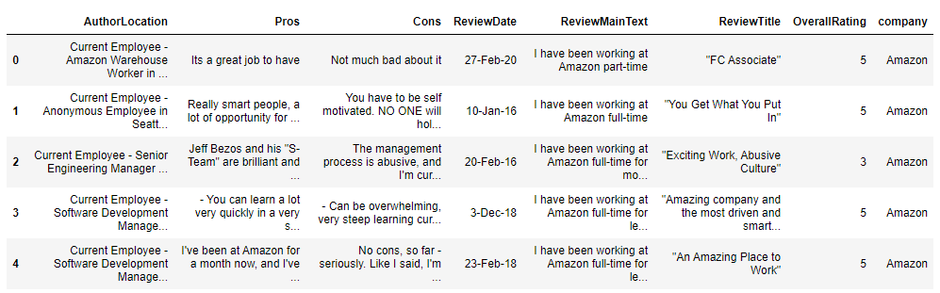
Generated Corpus

Slide 7

Preprocessing Corpus
1. Replace null values in reviews with empty strings
2. Fix Contractions
3. Remove Special Characters and numbers
4. Convert all the letters into lower case
5. Remove stop words using a list of customized stop words
5. Tokenization using word ninja library
6. Lemmatization using NLTK with POS tag

Slide 8
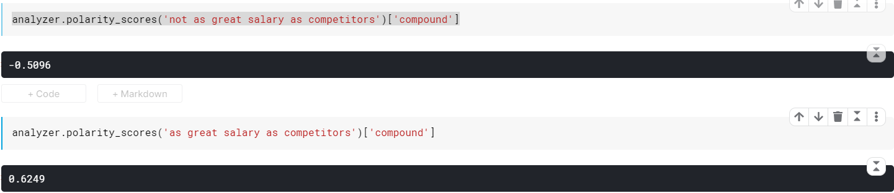
Customized Stop word List
Regular stop words list consist of ‘no', 'not’ etc.;
If those words are being removed from the review text the sentiment score calculated is not accurate, hence we created a customized list of stop words to resolve this type of issues.

Slide 9
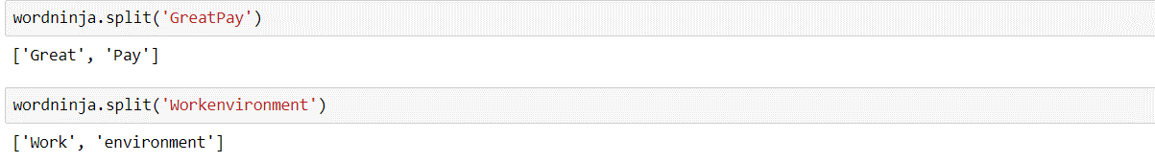
Tokenization
We identified certain words are not separated by space in review text, normal split will not work in this case hence we used ‘word ninja’ library for tokenization.

Slide 10
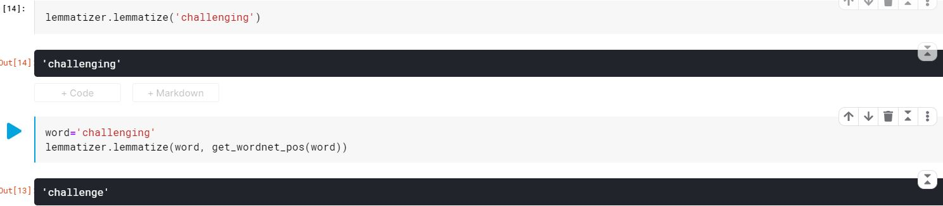
Lemmatization
Lemmatization is implemented using NLTK library
We observed that lemmatization works better for a word along with its POS tag

Slide 11
Text Cleaning
Text Before Cleaning
Text After Cleaning

Slide 12

Data Exploration & Visualization
Number of reviews per company
Distribution of rating by company
Word count in reviews

Slide 13
Reviews Count

Slide 14
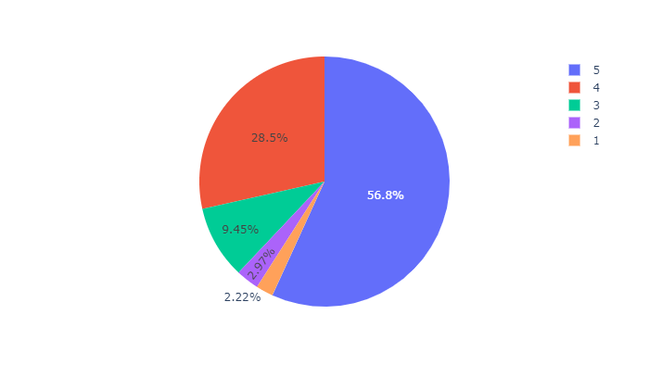
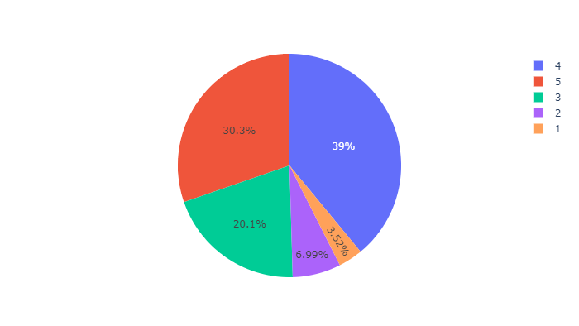
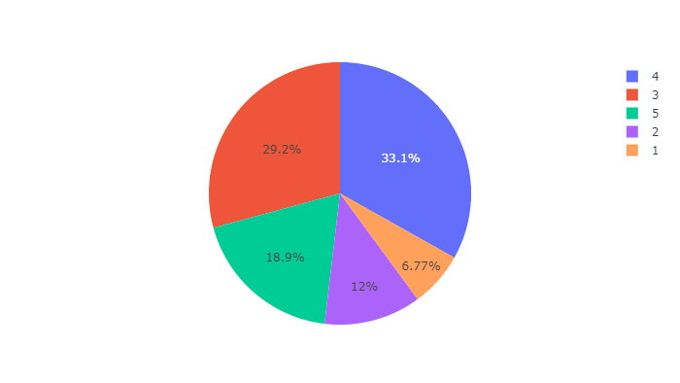
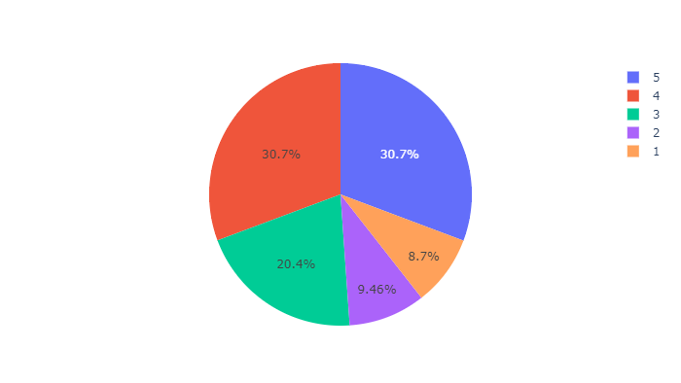
Ratings Distribution
Google
Microsoft
IBM
Amazon

Slide 15
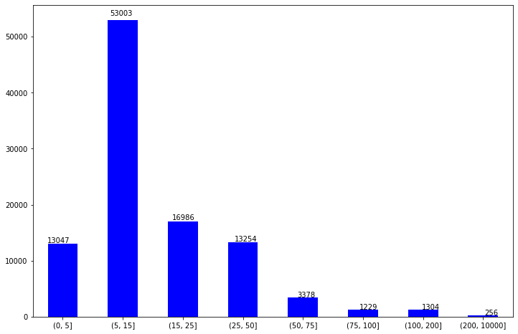
Review word count in Pros

Slide 16
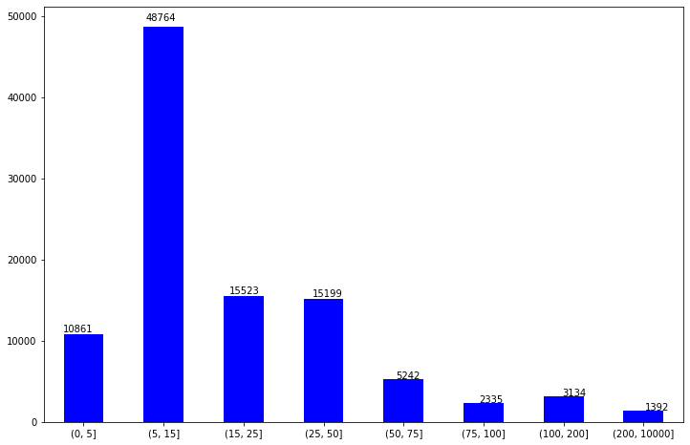
Review word count in Cons

Slide 17
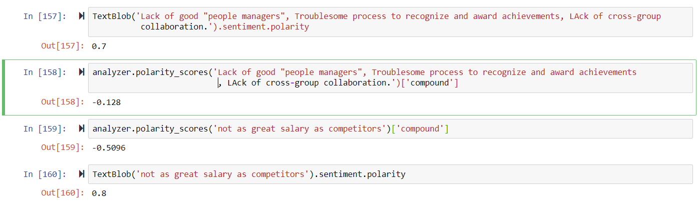
Sentiment Analysis
Text blob is not correctly identifying the sentiment score of sentences with negative context in this corpus
Hence we choose NLTK library for polarity score calculation

Slide 18
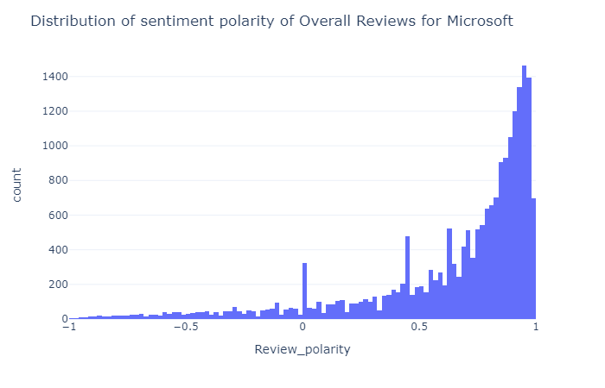
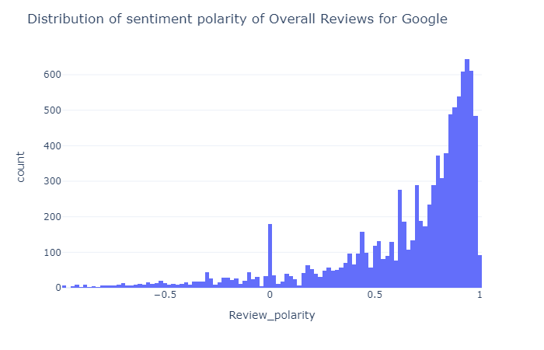
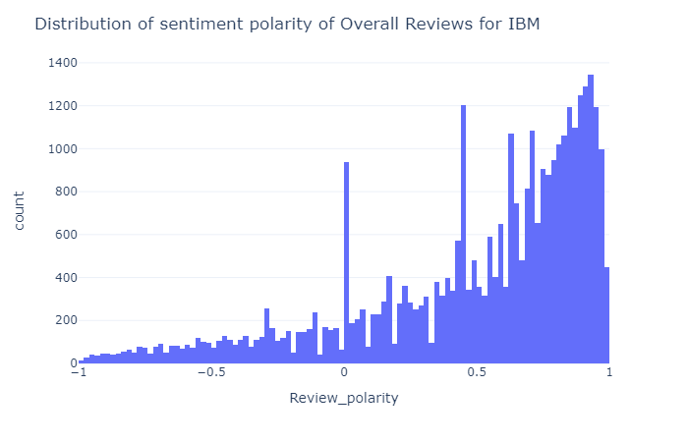
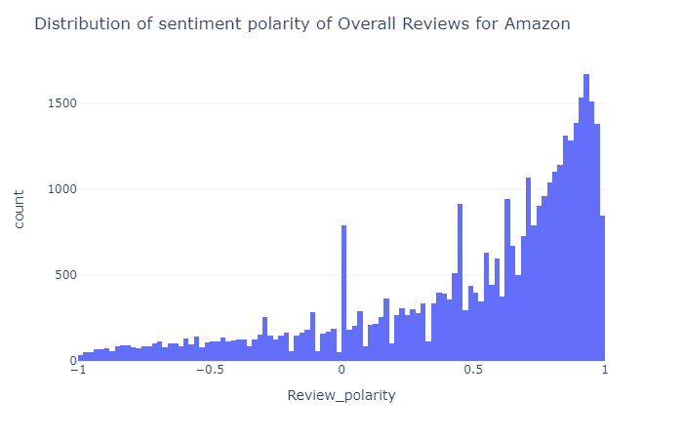
Review Polarity comparison

Slide 19
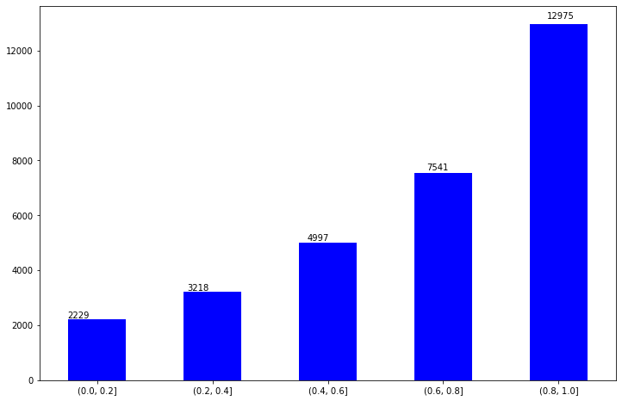
Sentiment Score Anomalies with Ratings

Slide 20

Identifying the keywords
Used Count vectorizer to generate bigrams and trigrams from text
The frequency of the n-grams was calculated to see the words that are most occurring
Top n-grams by frequency are used as input to similarity score analysis

Slide 21
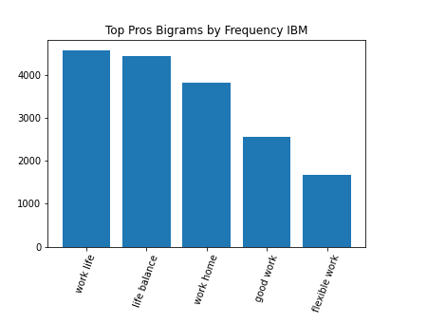
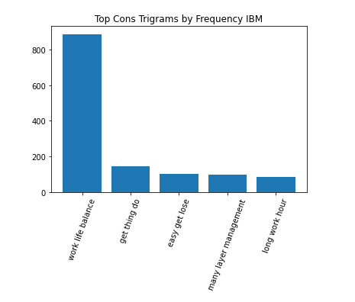
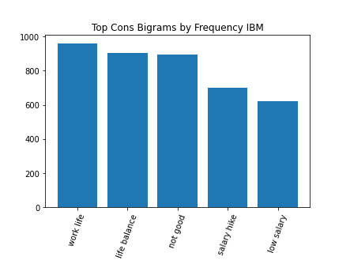
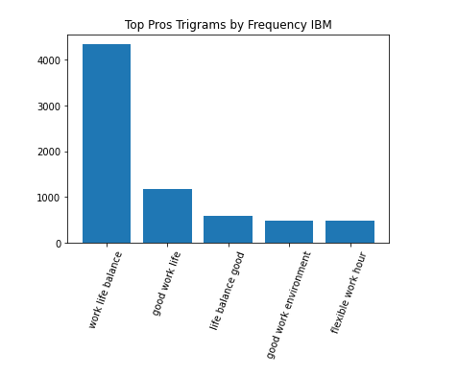

Slide 22

Similarity Score Analysis
Used Cosine Similarity to identify the similar keywords
Combined similar words into one parent word
The words along with its subsequent parent words are shown in next slide
Parent words with highest and lowest average ratings are marked as employer characteristics impacting the company perception positively or negatively

Slide 23
Identifying Similar Trigrams and Bigrams using Cosine Similarity
Bi Grams
'big company': ['big company', 'many people', 'not many', 'company not', 'may not', 'manager not', 'long time', 'become big', 'nothing bad', 'company work']
'low salary': ['salary hike', 'large company', 'less salary', 'low pay', 'salary increment',
'last year', 'not really', 'salary low', 'many layer', 'lay offs', 'salary less', 'less pay']
'life balance': ['fast pace', 'life balance', 'leadership principle', 'decent pay',
'flexible work', 'benefit great', 'best place', 'full time', 'place learn', 'feel like', 'talented people']
'free food': ['free food', 'work life', 'people work', 'good benefit', 'perk benefit', 'food great', 'great food', 'flexible work', 'good perk', 'good people', 'people good', 'food good',
'food gym', 'care employee', 'environment good', 'benefit work', 'perk good', 'perk free', 'perk food']
Tri-Grams
good work environment': ['good work environment', 'great work environment', 'learn new thing', 'work environment good', 'work culture good', 'work hard fun',
'lot opportunity learn', 'nice place work', 'good place learn', 'bring dog work', 'benefit good pay', 'good people work', 'opportunity learn grow',
'lot opportunity grow', 'customer centric company', 'learn new technology', 'good environment work', 'lot opportunity move', 'work home option',
'lot learn opportunity']
'long hour work': ['work long hour', 'hour short break', 'balance not good', 'not enough hour', 'hard work not', 'work hour per', 'not great work']
'life balance challenge': ['life balance challenge', 'great place work', 'mid level management',
'life balance difficult', 'long term career', 'many middle manager', 'good people leave', 'lack work life']

Slide 24
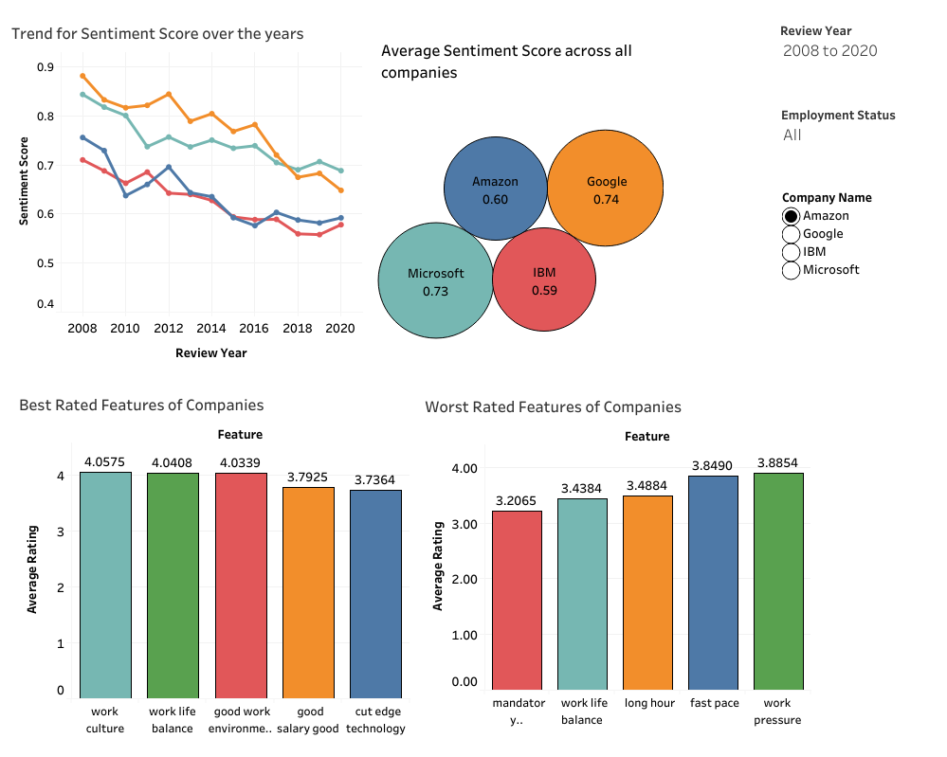
Dashboard

Slide 25

Insights
All the companies have seen a dip in their average sentiment score over the years
Google and Microsoft have highest employee satisfaction followed by Amazon and IBM
Employer brand for each company is identified. Below is the best and worst characteristic of each firm
Amazon – Work Culture and Mandatory Overtime
Google – Great Culture and Bad Work Life
IBM – Work Culture and Work Life Balance
Microsoft – Great Place to Work and Review System

Slide 26

Questions & Feedback

